Slide 1


Join at slido.com #3436682
ⓘ Start presenting to display the joining instructions on this slide.

Slide 2

Clearing the Air: Unveiling Insights on Health Through Data Analysis

Slide 3
THE Process
Data and PRocess

Slide 4
OpenWeatherMap Air Pollution API
Global Health Data Exchange
Australian Bureau of Statistics (2021) Regional Population
API NINJAS
Etc.
Study Objective:
Analyse key air pollution metrics at varying scales and over different timeframes to evaluate impact on public health and wellbeing.
Collation
Cleaning
2
Data Preparation
Descriptive Stats
1
Define
3
Exploratory Data Analysis
Graphical Stats
Input: Hypothesis
6
Review &
Feedback
4
Interpretation & Validation
5
Conclusions
Output: Reporting

Slide 5
LET’s HAVE SOME FUN
HYPOTHESES Q&A

Slide 6
Population question at global scale
Population question at the local scale – Australia
Seasonal question – Global
Pollutant v mental health correlation – Global
Pollutant v respiratory health challenges - Global

Slide 7

The greater the population size, the higher the recorded pollution in a town or city.
ⓘ Start presenting to display the poll results on this slide.
Notes:
Alvin

Slide 8
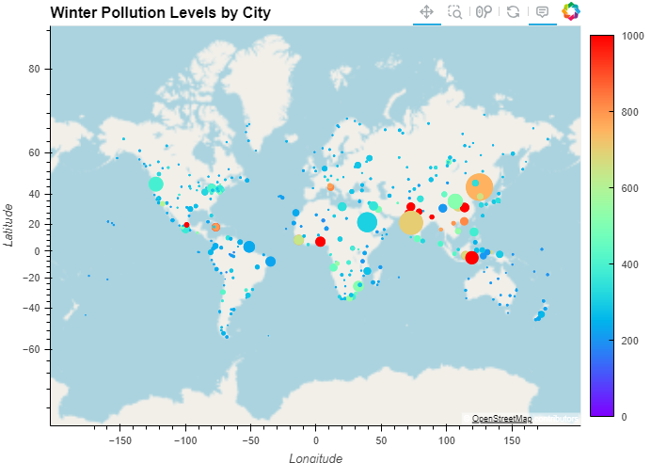
Global Winter CO Pollution Levels by Population (bubble size)
CO (μg/m³)
Correlation data
Notes:
Alvin

Slide 9
Higher population densities are associated with higher air pollution levels in Australian towns and cities.
ⓘ Start presenting to display the poll results on this slide.

Slide 10
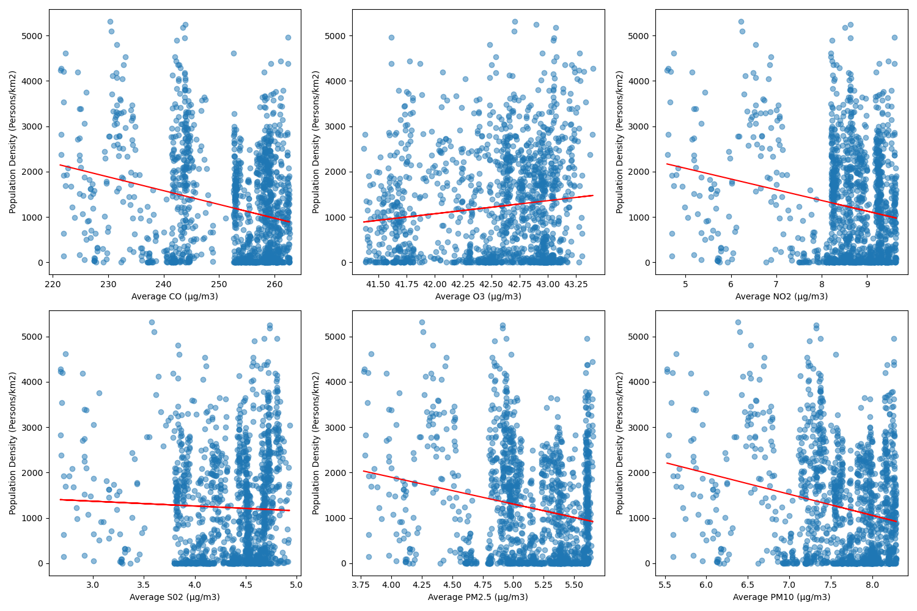
Notes:
Alvin

Slide 11
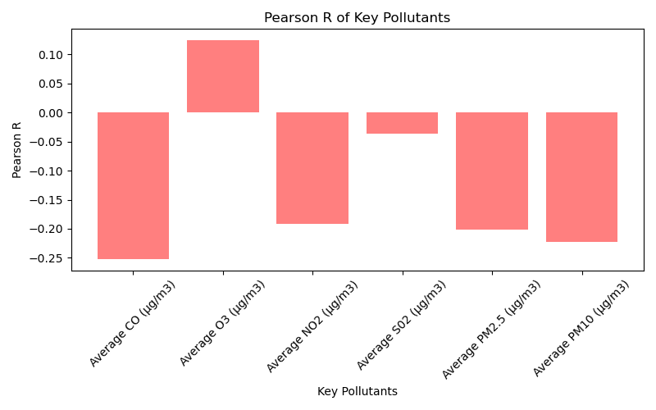

Slide 12
Lower population density: fewer sources of pollution per square km
Stringent environmental regulations: help to reduce emissions of air pollutants and improve air quality.
Geographic factors: Vast open spaces, prevailing winds, rainforest etc.
Low levels of industrial activity: fewer industrial sources of pollution

Slide 13
Pollutant levels vary significantly across the four season.
ⓘ Start presenting to display the poll results on this slide.

Slide 14
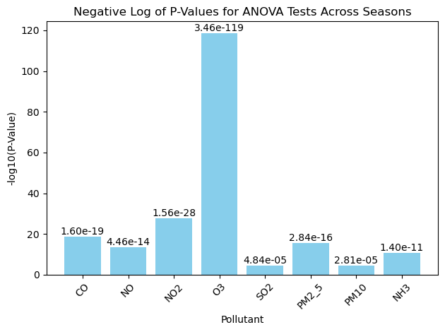

Slide 15
Higher levels of air pollutants correlate with higher occurrences of depressive disorders.
ⓘ Start presenting to display the poll results on this slide.

Slide 17
There are higher occurrences of respiratory disorders in towns and cities with higher levels of pollution.
ⓘ Start presenting to display the poll results on this slide.

Slide 19
CONCLUSIONS
SO WHAT ARE OUR THOUGHTS

Slide 21

THANK YOU

